Slide 1



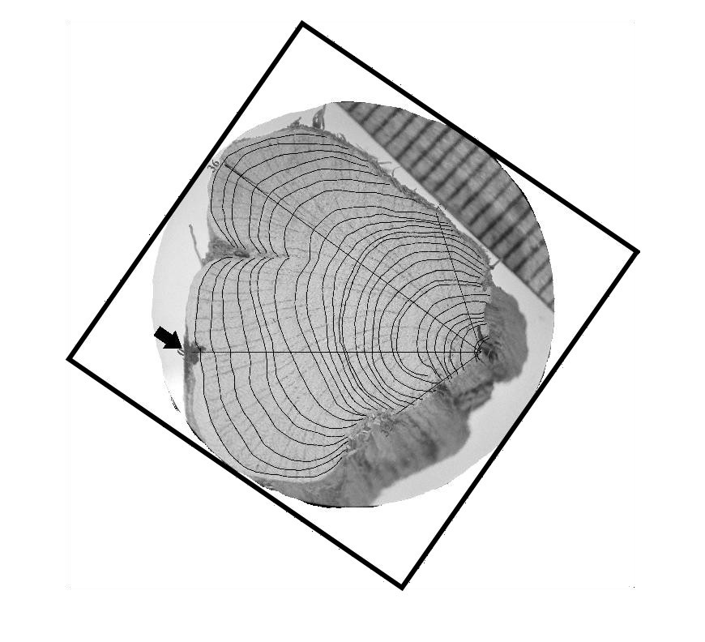
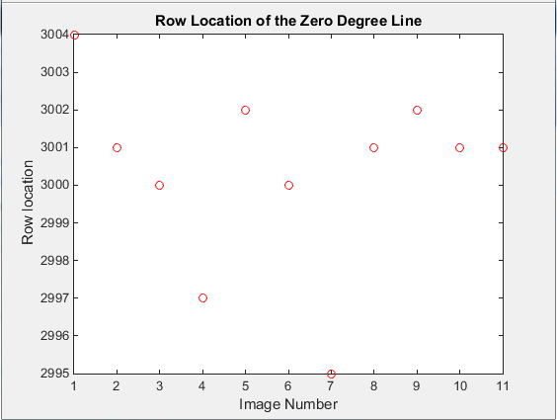
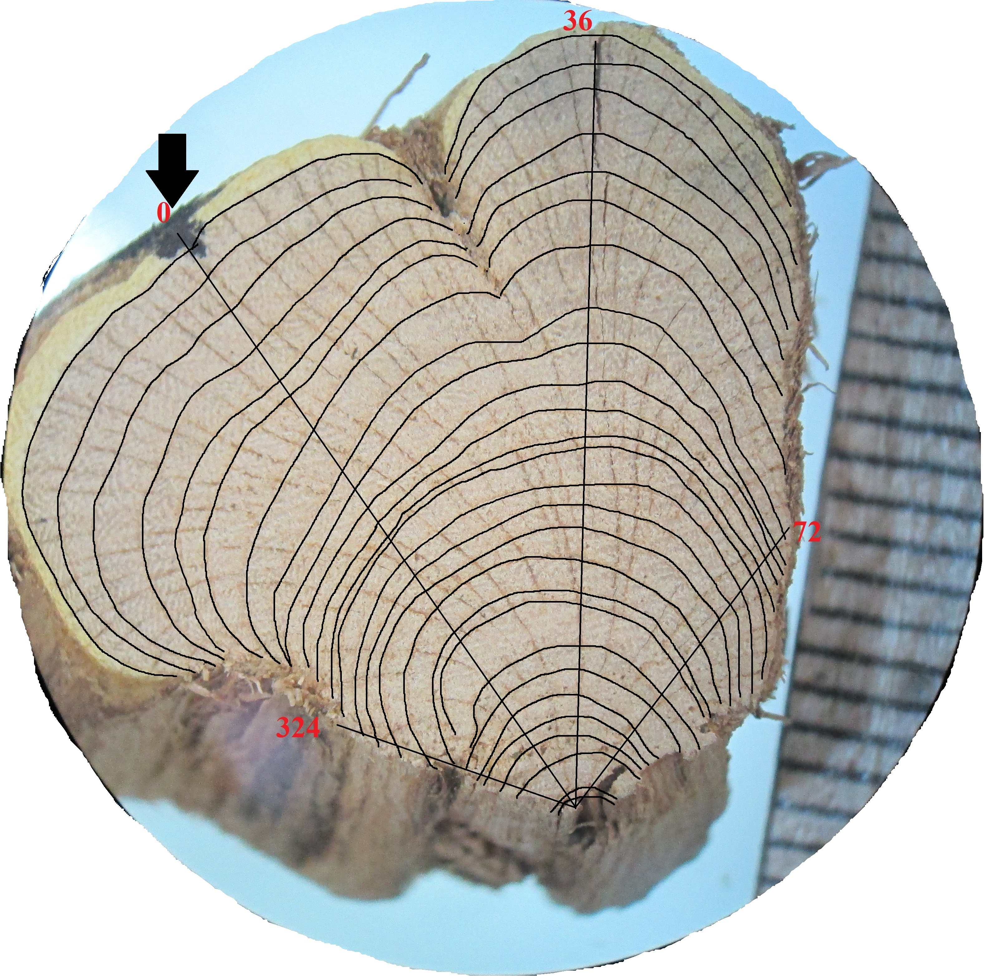
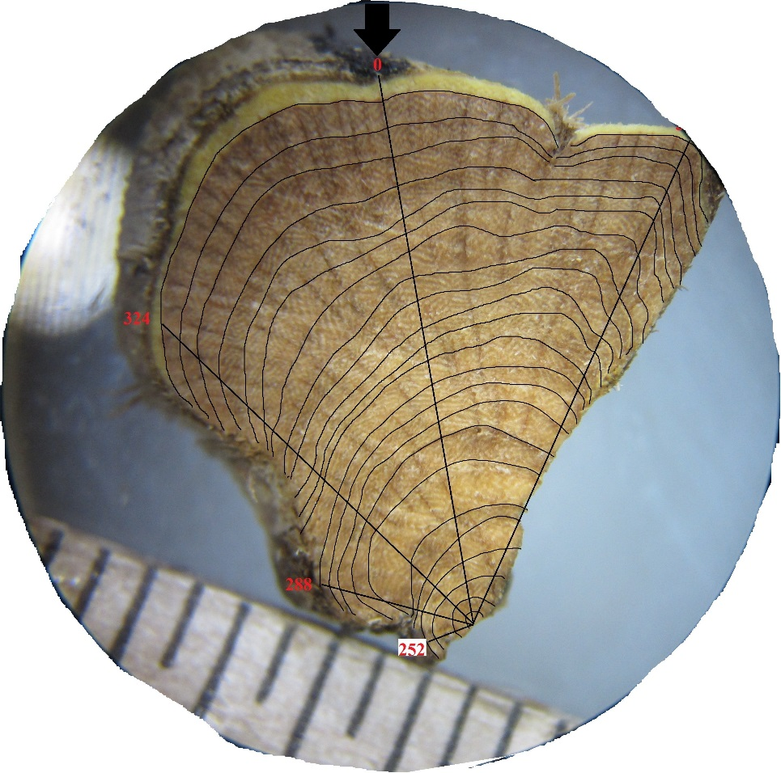

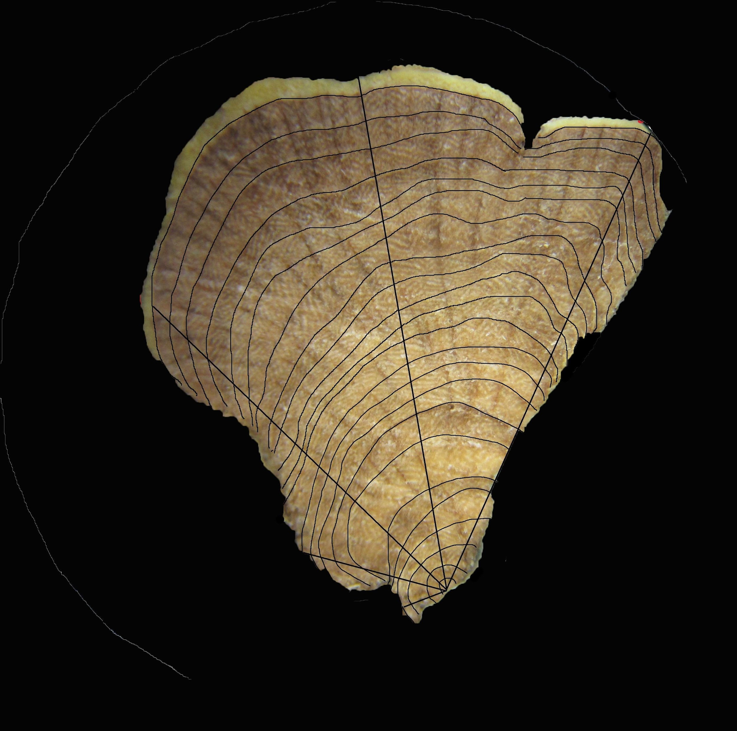
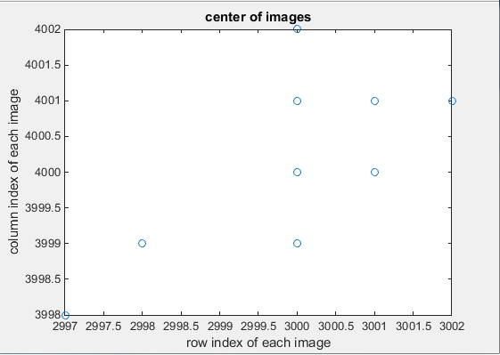
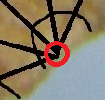
3D Visualization of Growth Pattern of Artemisia tridentata (Sagebrush)
Authors: Michael Scarinci¹, Katherine Encanarcion¹ and Nicholas Italiano¹
Advisors: Dr. Angel R. Pineda¹ and Dr. Lance Evans²
¹Mathematics Department, Manhattan College, Bronx, NY
²Biology Department, Manhattan College, Bronx, NY
Introduction
Image Calibration
Plants of Artemisia tridentata are dominant plants in the American southwest.
Many species of Artemisia tridentata show extensive eccentric growth, which probably limits its ability to grow tall.
The purpose of our study was to create an accurate pictorial 3-D representation of xylary rings of an eccentric stem.
Each xylary ring indicates a year of growth for the plant. Artemisia tridentata are the only known species displaying eccentric growth. It is believed they sacrifice ring growth in order to flower and reproduce.
Images were loaded into MATLAB and then scaled to the same resolution using the imresize function.
The images were then rotated to align the zero angle designated by the black line drawn in sample collection (Fig 2).
A
B
C
Fig 2. A) Sample before image calibration in MATLAB. B) A sample of an image completely calibrated. C) A graph representing the error in rotation of the samples based on the zero angle outlined in sample collection.
A
B
C
Images were then translated to have their biological centers aligned (Fig. 3).
Fig 1. A) The original sample image of one cut of the branch. B) A mask of the original image displaying only the branch, the bark was removed. C) The mask is applied to the original image to show the inner part of the sample.
Sample Collection
Stems were collected near Fremont Canyon, Utah.
They were prepared by Dr. Lance Evans’ lab at Manhattan College.
A vertical line was drawn on each stem in order to reconstruct the stem following cutting. This allowed for orientation to remain the same for different slices.
For each stem, segment sectors were drawn and xylary rings were labeled (Fig 1A).
A
B
Fig 3. A) Zoomed image showing the biological center used for aligning the images. B) A plot of the error in translation of each image.

Slide 2
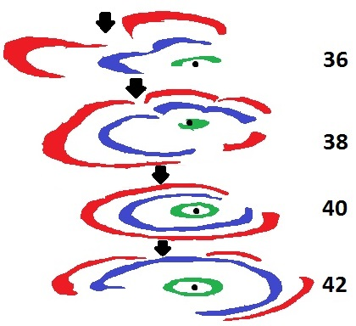
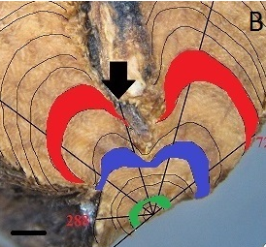
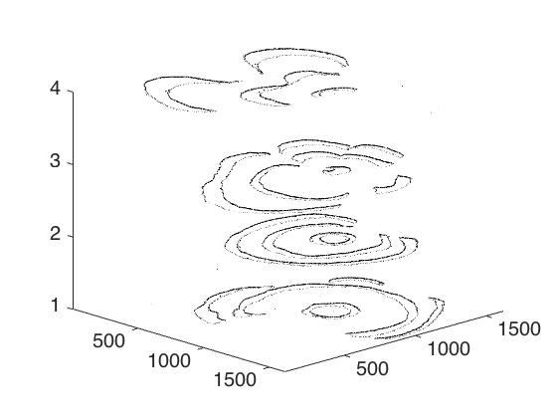
3D Visualization of Growth Pattern of Artemisia tridentata (Sagebrush)
Authors: Michael Scarinci¹, Katherine Encanarcion¹ and Nicholas Italiano¹
Advisors: Dr. Angel R. Pineda¹ and Dr. Lance Evans²
¹Mathematics Department, Manhattan College, Bronx, NY
²Biology Department, Manhattan College, Bronx, NY
Xylary Ring Reconstruction
RESULTS (CLICK TO EDIT)
Xylary Ring 3, 7 and 10 were colored for visualization of the eccentric growth per year.
Fig 6. Final volume visualization of samples 36, 38 40 and 42. The black dot is the biological center and the arrow is the location of the zero angle.
Fig 4. Ring 3, 7 and 10 are colored in green, blue and red respectively.
Ring Visualization
Discussion
With only a few centimeters separating the two samples, there was a significant difference in their ring arcs and area.
Calculating these percentages and areas we are able to identify that ring 10 for Sample 36 was more than twice the area for Sample 42 (Fig 6).
Future Work
An application of this study would be creating a predictive model of xylary ring growth utilizing the location of the complete rings and partial rings, percentages of individual arcs and the ring areas.
Initial work on a full 3D visualization of plants from sample images has yielded promising progress (Fig 7).
Fig 5. Raw volume visualization of samples 36, 38, 40 and 42.

Slide 3
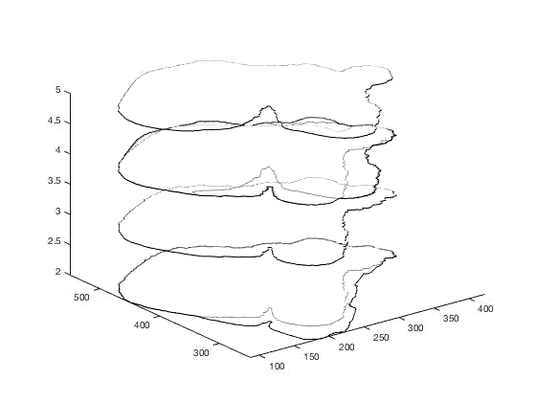
3D Visualization of Growth Pattern of Artemisia tridentata (Sagebrush)
Authors: Michael Scarinci¹, Katherine Encanarcion¹ and Nicholas Italiano¹
Advisors: Dr. Angel R. Pineda¹ and Dr. Lance Evans²
¹Mathematics Department, Manhattan College, Bronx, NY
²Biology Department, Manhattan College, Bronx, NY
Interpolation of Sample Slices
Movie #1: 3D Interpolation between two samples created additional rings also visualized in Figure 8a.
Notes:
Should I say what samples? Like sample XX(top) and sample XX (bottom) is XX

Slide 4
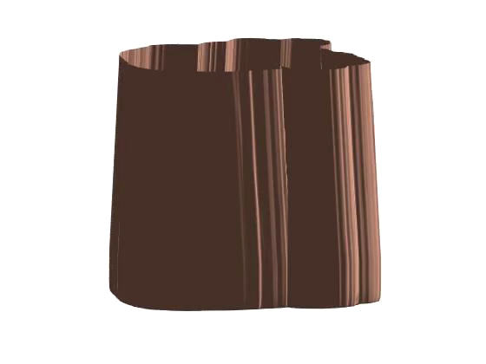
3D Visualization of Growth Pattern of Artemisia tridentata (Sagebrush)
Authors: Michael Scarinci¹, Katherine Encanarcion¹ and Nicholas Italiano¹
Advisors: Dr. Angel R. Pineda¹ and Dr. Lance Evans²
¹Mathematics Department, Manhattan College, Bronx, NY
²Biology Department, Manhattan College, Bronx, NY
3D Surface Visualization
Movie 2: Surface created from applying 3D visualization techniques to interpolated volume as illustrated in figure 8b.

Slide 5
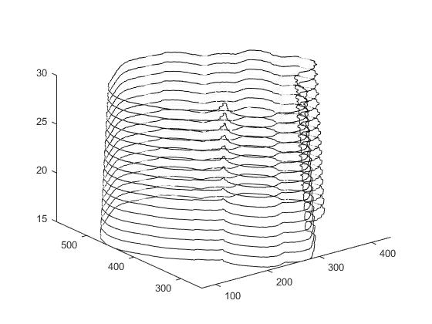
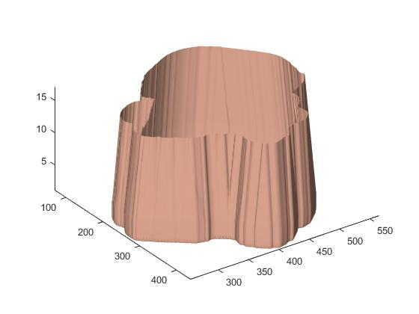
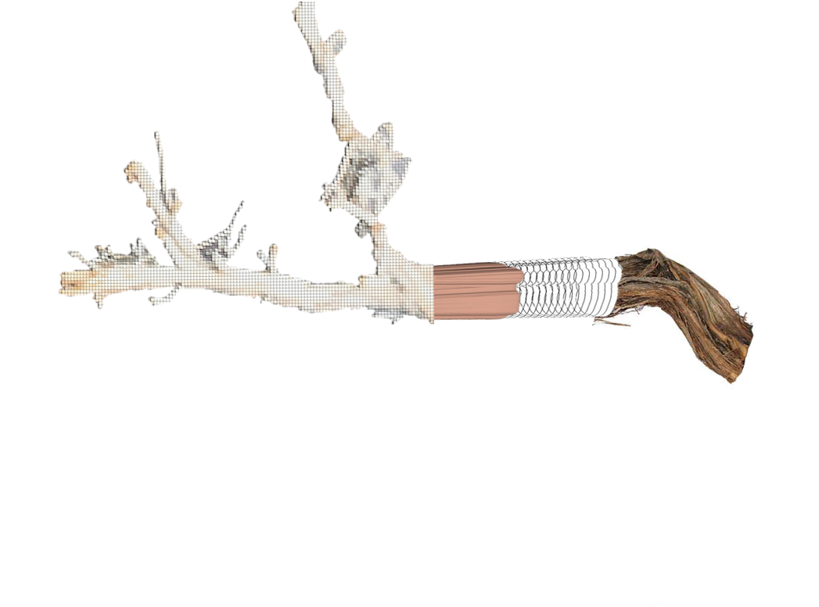
3D Visualization of Growth Pattern of Artemisia tridentata (Sagebrush)
Authors: Michael Scarinci¹, Katherine Encanarcion¹ and Nicholas Italiano¹
Advisors: Dr. Angel R. Pineda¹ and Dr. Lance Evans²
¹Mathematics Department, Manhattan College, Bronx, NY
²Biology Department, Manhattan College, Bronx, NY
A
B
Fig 8. A) View of additional volume slices created between sample 42 and 43 B) Visualized surface using additional slices.
Fig 8. Concept of what a full 3d volume visualization would look like using image processing tools in MATLAB.
Acknowledgments
Interpolation and morphing methods were used to create additional slices between samples and construct a surface morphed to model eccentric growth (Fig 7).
Financial support from the Catherine and Robert Fenton Endowed Chair at Manhattan College.
Student travel support from the Society for Industrial and Applied Mathematics (SIAM).
References
1. Evans, L. S., A.Citta and S. Sanderson. 2012. Flowering branches cause injuries to second-year stems of Artemsia tridentata Nutt. subspecies tridentata. Western North American
Naturalist. 72: 447-456.
2. Derek L G Hill, Philipp G Batchelor, Mark Holden and David J Hawkes. 2001. Medical image registration in Phys. Med. Biol. 46 R1–R45.

